Slide 1
An Orientation to the Strategic Prevention Framework – State Incentive Grant (SPF SIG)

Slide 2
Introductions
Who we all are…

Slide 3
Overview of the Day

Slide 4
Background on SPF SIG

Slide 5
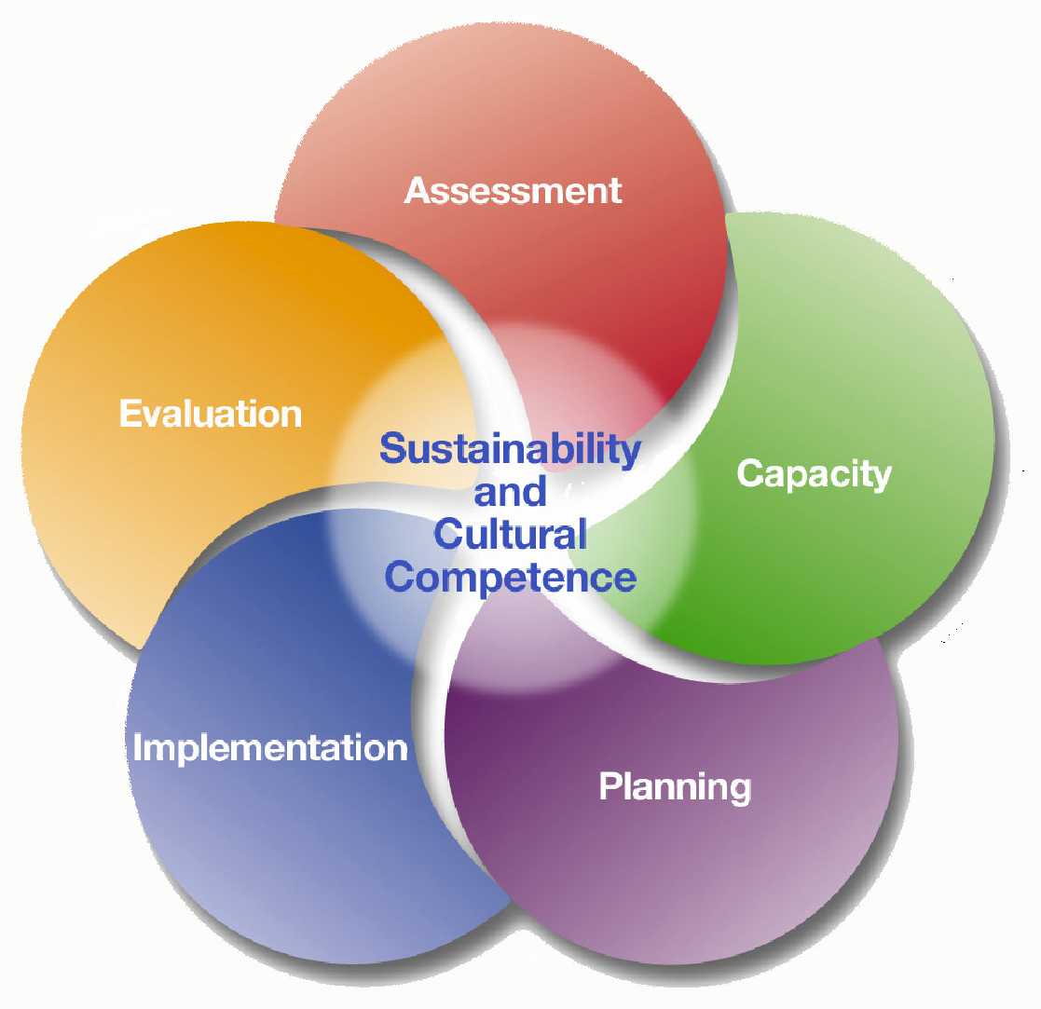

Slide 6
How did we get here?

Slide 7
Introduction to the
Logic Models

Slide 8
SCIENCE
PRACTICE

Slide 9
17 yrs
“It takes 17 years to turn 14% of original research
to the benefit of patient care” *
Original research
Submission
Unknown
0.5 year
0.6 year
0.3 year
6. 0 - 13.0 years
9.3 years
Acceptance
Publication
Bibliographic databases
Reviews, guidelines, textbooks
Implementation
*Balas, 1995
Lawrence W. Green, Dr. PH
Univ of California at San Francisco School of Medicine
Notes:
9

Slide 10
3 Conceptualizations of the Gap Between Research & Practice
Practitioners need to receive the lessons of research and put them into practice.
Research and practice are entirely separate disciplines and each must develop their own answers to their own problems
Research and practice have complementary perspectives and skills that need to be used together to address the real need, collaborative knowledge production.
Van De Ven A, Johnson P. Knowledge for theory and practice. Academy of Management Review. 2006;31(4).

Slide 11
So what would serve as a “bridge” between Science and Practice?
SCIENCE
PRACTICE

Slide 12
Various Efforts
Communities That Care (CTC)
Getting to Outcomes (GTO)
Strategic Prevention Framework (SPF)

Slide 13
What does SAMHSA want?
To develop prevention infrastructure to support evidence-based interventions to….
  Reduce excessive drinking among
  12 to 25 year olds
  Achieve that reduction at a
  community level
  Demonstrate that achievement
  via formal evaluation

Slide 14
OMG!
Notes:
Implicit assumption that the only “target” is high-risk drinkers
Ambivalence about underage drinking
Low perceived efficacy of preventive interventions
Challenges of coordination and resource allocation
Possible fears of “backlash”

Slide 15
OMG!!!!

Slide 16
but it’s possible…
…maybe even likely!

Slide 17
Examples of Successful Community Prevention Interventions
COUNTRY
GOALS
STRATEGIES
RESULTS
United States
California/
South Carolina
Reduce alcohol injury and death
• DUI enforcement
• Alcohol service
• News coverage
• Underage sales
• Alcohol outlets
➢
10% reduction in alcohol crashes
➢
43% reduction in violence
➢
Lower alcohol sales to youth
Minnesota
Reduce youth drinking
➢
Lower alcohol sales to youth
Reduced traffic crashes
• Local sales policies and enforcement
➢
Massachusetts
Reduce alcohol crashes
• News coverage
• DUI enforcement
• Alcohol outlet
surveillance
➢
25% reduction in fatal crashes

Slide 18
Examples of Successful Community Prevention Interventions
COUNTRY
GOALS
STRATEGIES
RESULTS
Sweden
STAD Project
Stockholm
Reduced local alcohol and drug problems
Responsible Beverage Service
Joint parent/police enforcement of sales to youth.
Club policy & and drug recognition by door security.
➢
Reduction in sales
to intoxicated
patrons (47% to 5%)
➢
Violent crime
down by 29%
➢
Refusals of drug impaired patrons increased by 300%
Australia
Surfers Paradise Safety Action Project
Lower alcohol involved violence
Community Forum & alcohol safety audit
Model House Policies
Increased enforcement of alcohol licensed premises
➢
Reduction in Violent events: --original site from 9.8 to 4.7
➢
replication sites from 12.2 to 3.0

Slide 20
there’s more to implementation than specifying the steps…

Slide 21
Ineffective Methods
Excellent experimental evidence for what does not work
Diffusion/dissemination of information by itself does not lead to successful implementation (research literature, mailings, promulgation of practice guidelines)
Training alone, no matter how well done, does not lead to successful implementation
Fixsen, D. L., Naoom, S. F., Blase, K., Friedman, R. M., & Wallace, F., 2005

Slide 22
What Works
Effective intervention practices and programs
+
Effective implementation practices
= Good outcomes
No other combination of factors reliably produces desired outcomes
Fixsen, D. L., Naoom, S. F., Blase, K., Friedman, R. M., & Wallace, F., 2005

Slide 23
Effective Use of EBP
Stages
RESEARCH
IMPLEMENTATION
PRACTICE
Drivers
GAP
Fixsen, D. L., Naoom, S. F., Blase, K., Friedman, R. M., & Wallace, F., 2005

Slide 24
…so what’s our “driver?”
Logic Models

Slide 25
Logic Models
A tool to describe a theory of change underlying an intervention, policy, or program, i.e., how it’s supposed to work
Lays out a chain of events that leads from interventions to results
Clarifies knowledge of what works and why
Different types of logic models (e.g., theory of change vs. program logic)

Slide 26
Basic Question
“Why are automobile crashes more prevalent in one community than another?”

Slide 27
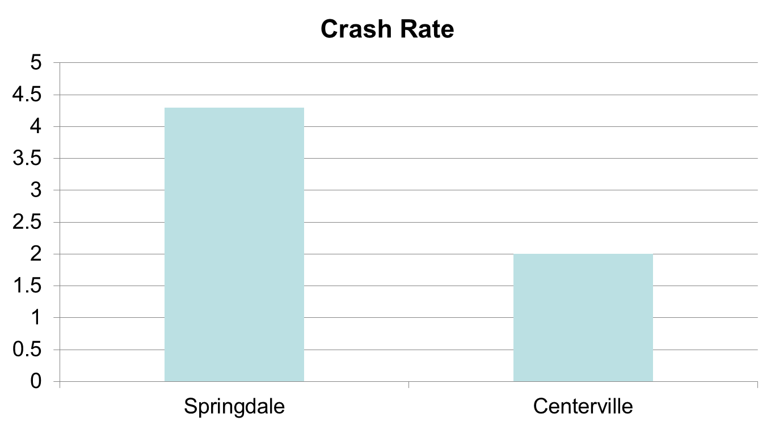
Crashes by City
(all types)

Slide 28
Basic Question
“Why is underage drinking more prevalent in some communities than others?”

Slide 29
Underage Drinking:
Basic Research
Evidence: Population Prevention Effects
Strong
Moderate
Low (target group only)
None (no target or population)
Visible Enforcement
Retail Availability of Alcohol to Youth
Price
Alcohol-Related Problems
(Traffic crashes, Injuries,
School performance. Unsafe sex, Violence, etc.)
Social Availability of Alcohol to Youth
Underage Drinking Laws
Underage Drinking
Drinking Beliefs
Community Norms About Youth
Drinking
Family, School, and Peer Influence
Drinking Context
Alcohol Promotion (Advertising, Point of Sale Promotion , Sponsorship of Community Events)

Slide 30
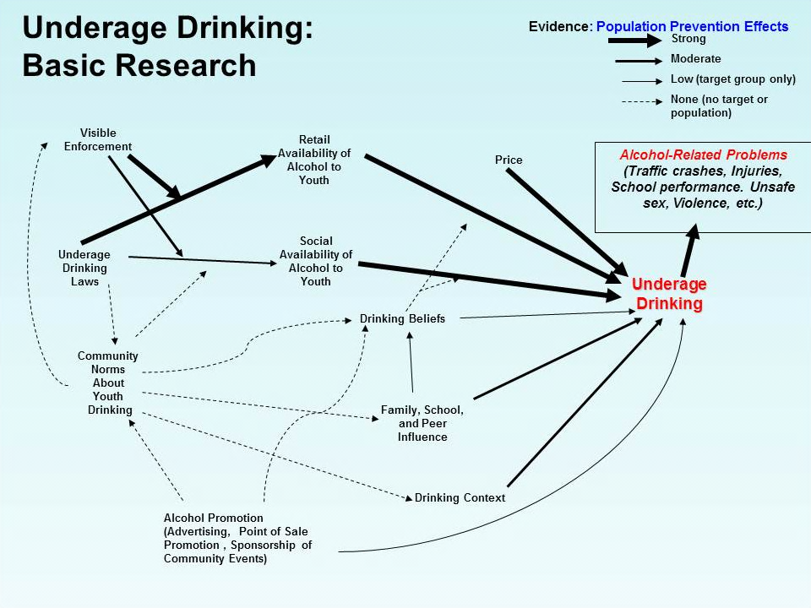
Reward &
Reminder
Retail Serving Practices
Decoy
Operations
Nuisance Party Patrols
Social Host
Liability
DUI
Enforcement

Slide 31
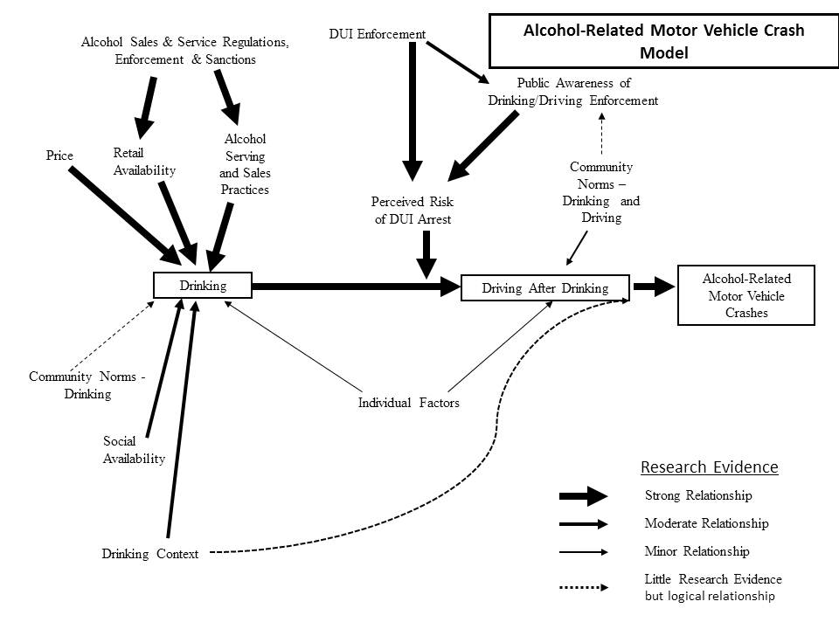

Slide 32
DUI
Enforcement
Retail Serving Practices
Nuisance Party Patrols
Social Host
Liability

Slide 33
…this is getting complicated
…and we haven’t even added the implementation details, yet!!

Slide 34
Time for Exercise 1

Slide 35
How will we use these models?

Slide 36
Virtues of Logic Models
They will pinpoint areas of uncertainty, confusion, or disagreement among members of the planning team.
They can identify false assumptions that need to be addressed.
They enhance communication among people involved in the intervention.
They help guarantee that all program activities and policies can be logically linked to the achievement of specific objectives – i.e., help stay on track
They can serve as an educational and communications tool when a new program or policy is being implemented.
They can be a tool for tracking changes in the intervention or its implementation.
They inform any evaluation

Slide 37
The models will also help us move efficiently through the SPF steps

Slide 38
Common Liabilities of
Conventional Approaches
Vague objectives for “Assessment” phase
Easy to get lost in data gathering

Slide 39

Paralysis by analysis…

Slide 40
Common Liabilities of
Conventional Approaches
When turning to “planning,” data often do not indicate strategy

Slide 41
Common Liabilities of
Conventional Approaches
When turning to “capacity building”…
Some “stakeholders” don’t want to be there
Some “stakeholders” should not be there

Slide 42
Common Liabilities of
Conventional Approaches
When turning to “management”…
Often too much emphasis on “process” rather than “outcomes”

Slide 43
So how do we move from concepts to action?
Very simple, interactive software designed for group strategizing
Focus is on the specific steps that will achieve a change in each main prevention target (e.g., “retail availability”)

Slide 44
How it looks in practice

Slide 45
Sample Page from
Interactive Logic Model
Alcohol-Related Problems
(injury, school performance, unsafe sex)
Alcohol-Related Harm
Underage Drinking
30-day use; “binge” drinking
Price
Retail Availability of Alcohol to Youth
Social Availability of Alcohol to Youth
Alcohol Promotion
Drinking Context
Family, School, and Peer Influence
Drinking Beliefs
Average retail price of beer
Youth Buyer Survey
Sources of Alcohol
Point of Purchase Ads; General Advertising
Drinking Settings & Situations
Perceptions of Norms
Normative Beliefs
For software: www.doview.com

Slide 46
Sample Page from Interactive Logic Model (a level down from prior page)
Retail Availability of Alcohol to Youth
Social Availability of Alcohol to Youth
Retail Training & Rewards
Visible Enforcement
Underage Drinking Laws
Community Norms
about Youth Drinking
Adult Perceptions of Norms
Number of Compliance Checks, Shoulder Taps, Party Patrols
Compliance Checks, Citations, License Loss
Local Alcohol Policy
Party Patrol, Shoulder Taps, Keg Registration
Perceived Risk for Providing Alcohol to Underage
Media Advocacy
For software: www.doview.com

Slide 47
Social Availability of Alcohol
Youth Access to Home Alcohol Supply
Youth reports of alcohol availability in home
Alcohol Availability at Special Events
Parties/social events in which alcohol is available
Youth reports of number of social events in which alcohol is available
Parental drinking and provision of alcohol to other children
Youth reports of provisions of alcohol by adults, not their parents
Visible Police enforcement of social availability of alcohol to youth, e.g. party patrols
Explore Cloverdale Social Host Ordinance
Cloverdale Teen Party Ordinance
Provide information to adults about legal risks for providing alcohol to underage youth
Number of public information pamphlets and PSAs concerning legal risks
Monthly counts of news stories about legal risks
Monthly police enforcement actions to reduce social availability to youth.
Project SUCCESS Program
Every 15 Minutes Program
DARE Program
Boys & Girls Clubs Smart Moves Program & Parenting Class
Extreme Responders, Intro Law Enf. Classes
Citations, warnings, or arrests for providing alcohol to underage persons.

Slide 48
Example as it looked at the time…

Slide 53
Key Elements of the Approach
Clarifies partnership of science and practice:
  Research prescriptive about what to do
  Local expertise on how to do it
Highly focused on objectives rather than process
Moves quickly through assessment and planning, and gets into action
Focuses on measurable community-level outcomes

Slide 54
Time Line
Schedule first workgroup meetings at home as soon as your team is available (contact Rick McGaffigan).
Complete assessment and planning in 2 or 3 meetings by end of January, 2013.
Initiate interventions first quarter of 2013.
We will be available for support
We will be holding webinars and conference calls as needed.

Slide 55
Time for Exercise 2

Slide 56
Evaluation
How will we know that it worked?

Slide 57
Time for Exercise 3

Slide 58
Frequently Asked Questions

Slide 59
Reporting and
Other Logistics

Slide 61
Pre-condition Intervention “Post-condition”
“Black Box”

Slide 62
Sources
Minutes from planning meetings (already gathering)
Reports from counties and municipalities
Qualitative interviews with key personnel and planners

Slide 63
RBS Reporting Form
Activities | Date(s) | Degree of visibility
Develop contact list for licensed businesses
Number of alcohol outlets contacted
Number of alcohol outlets agreeing to train staff
RBS training
Visibility
Send out notices that RBS training is available
Develop a news release publicizing the problems that can be addressed by RBS
Develop materials (e.g., table tents) that on-premise outlets can use to educate patrons
Degree of visibility: | A: High visibility (Appeared in several outlets) | B: Some visibility (Two or three) | C: One mention | D: No visibility

Slide 64
Next Steps…

Slide 65
“You've got to be careful if you don't know where you're going because you might not get there”
Yogi Berra

Slide 66
Thank You!

